Slide 1

Bakery Database Management System
Group 8: Ronaldo Martinez, Barry Shawn McCoy, Eman Arshad, Krupa Patel, Maybelline Melissa Medrano, Victor E Chavez, Angelo S. Angel

Slide 2
Group members
Angelo Angel
Barry McCoy
Victor Chavez
Eman Arshad
Krupa Patel
Rolando Martinez
Maybelline Medrano

Slide 3
Summary
The primary goal of our bakery database design is to enhance efficiency by implementing strategic business rules. These rules are geared towards advancing technologies, fostering innovation, and enhancing customer experiences. Specifically, our focus lies on improving customer engagement, streamlining inventory management, optimizing payment processing, facilitating order placement, promoting sustainability initiatives, and nurturing employee development through training.

Slide 4
Business scope
One business; no other branches or warehouses.
Since it is a small business, there’s only one loyalty program.
Bakery goods are the only products sold. Ingredients and equipment are not sold.
We do not provide delivery options.
It’s possible for baked goods to inherit allergens that should not be ordered and eaten by customers not tolerant against it.
Each product has unique nutritional information.
Employees must be trained before being assigned a role.
If any step is skipped or missed, a product would be miscreated.
Without a waste log there would be not be way to track profit or losses within the company.
We do not require a deposit for a catering event.

Slide 5
Business scope (continued)
It’s possible for customers to use their relatives’ cards during purchase; however, the order is still tied to them.
Each event may have many caterings. Therefore, an Event’s caterings should determine the total revenue for this event.
A customer may be invited to many events, then we can determine whether they attended or not.
It is not possible for a customer to cater every product we offer for an event.
We only apply one tax for each payment.
Suppliers provide invoices after supplying inventory items (ingredients and equipment) which are then recorded to our expenses.
The business owns many company cards that are used for paying expenses.

Slide 6
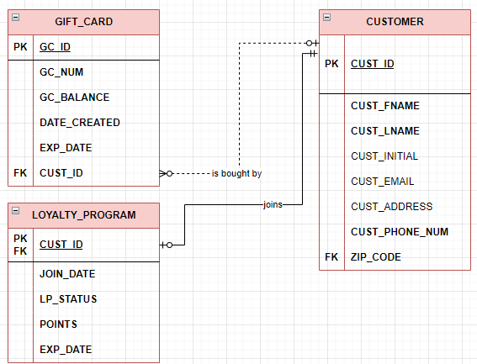
Customer onboarding and loyalty Program
CUSTOMERs are given an option to buy many GIFT_CARDs every purchase.
New CUSTOMERs are prompted to have choice of joining the LOYALTY_PROGRAM or not.
If CUSTOMERs join the program, their PK is referenced by LOYALTY_PROGRAM as both PK and FK, showcasing the table’s dependency on CUSTOMER table.
LOYALTY_PROGRAM can be seen as an extension of the CUSTOMER table for customer instances that join the program.

Slide 7
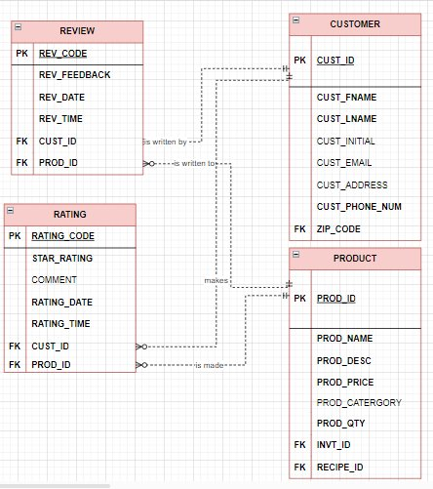
Customer ratings and Reviews
CUSTOMER can write multiple REVIEWS as well as make multiple RATINGS
One product may have many review and ratings
a REVIEW and RATING can only be written by one CUSTOMER
a REVIEW and RATING can only be about one product

Slide 8
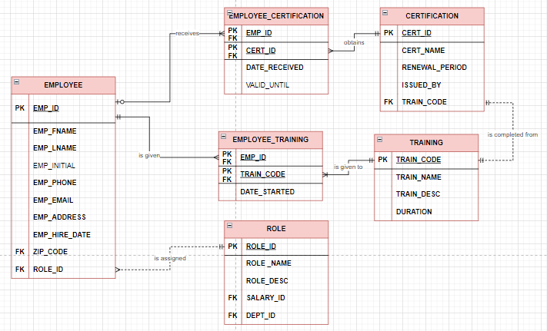
Employee training
An EMPLOYEE must go through TRAINING to receive a CERTIFICATION
An EMPLOYEE can go through multiple TRAININGs and receive multiple CERTEIFICATIONS.
Without proper TRAINING an EMPLOYEE will not be assigned a role.
When a TRAINING is completed an EMPLOYEE is assigned a CERTIFICATION.

Slide 9
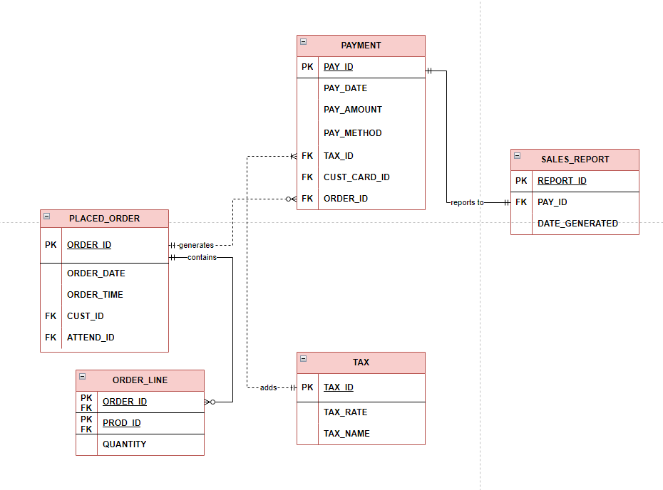
Payment, taxes and sales reporting
When an Order is placed it can generate many payment
The PAYMENT is reported to SALES REPORT via the PAY_ID which appears as the FK in the report table
The PLACED ORDER contains many ORDER LINEs which are determined by the ORDER ID
A TAX_ID is placed on the PAYMENT as an FK which determines the RATE and NAME on the TAX table

